Slide 1
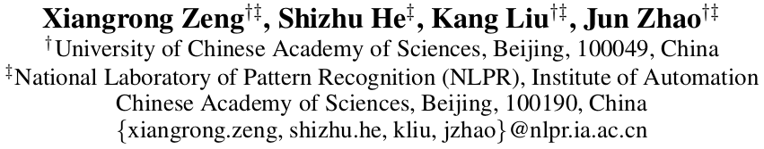
Large Scaled Relation Extraction with Reinforcement Learning

Slide 2
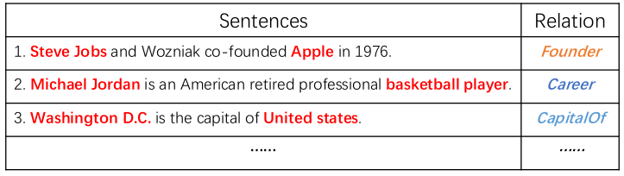
Relation Extraction

Slide 3
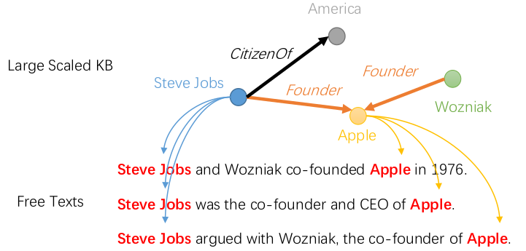
Automatically generate large scaled dataset

Slide 4
Distant supervised Relation Extraction
Sentences in the distant supervised dataset are not directly labeled
Not all sentences that mentioned an entity pair can represent the relation between them

Slide 5
This paper
Apply reinforcement learning method to learn sentence relation extractor with the distant supervised dataset
Achieves 13.36% improvement

Slide 6
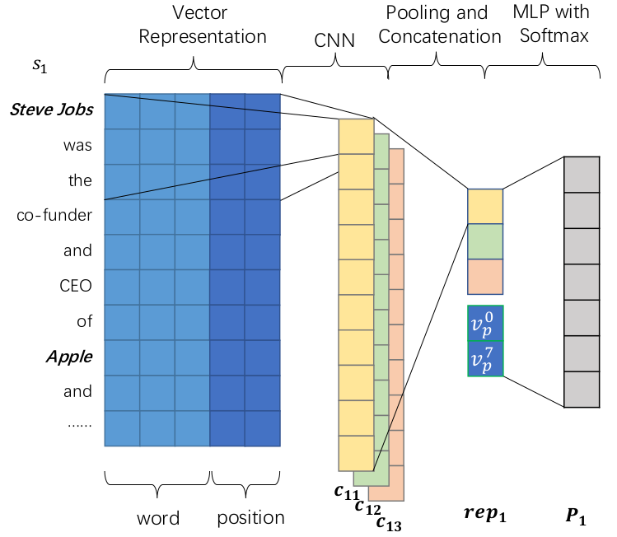
Relation extractor
Notes:
position enhanced CNN

Slide 7
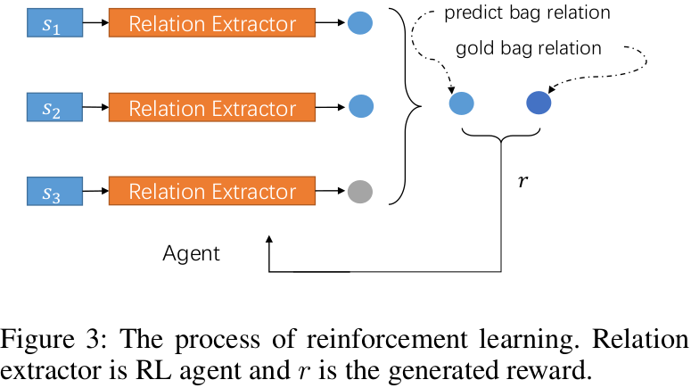
Training with RL
Notes:
Sentences : states
Relations: actions
Relation extractor: RL agent

Slide 8
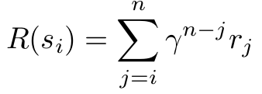


Training with RL
Notes:
Rn is set to 1 or -1

Slide 9

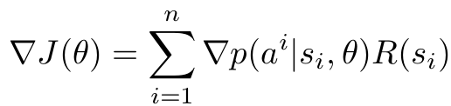
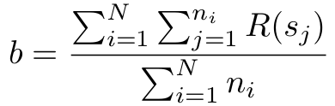
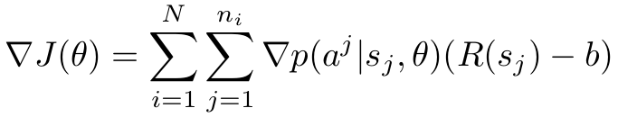
Training with RL
Notes:
b: to reduce variance and make training faster and more stable

Slide 10
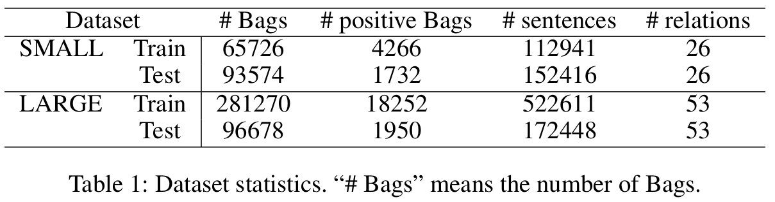
Datasets

Slide 11
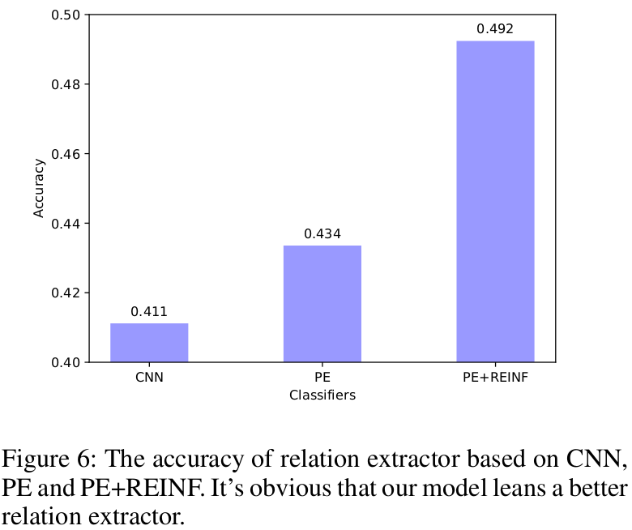

Slide 12
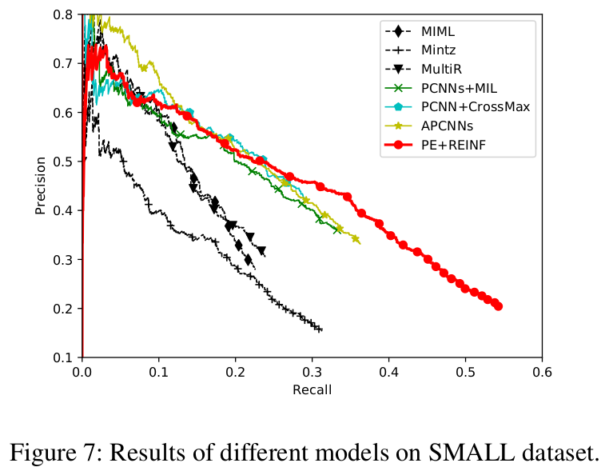

Slide 13
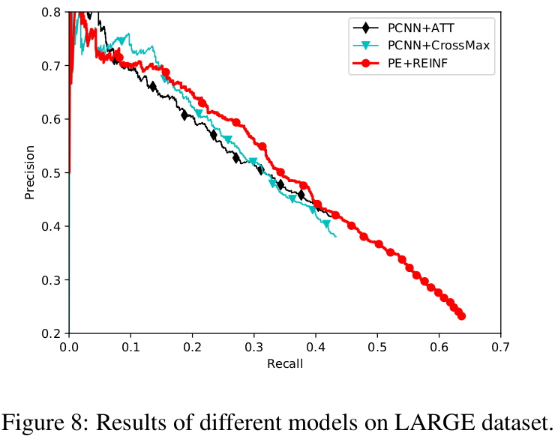

Slide 14
